Slide 1


Absorptive Capacity and SME Business Performance:
A meta-analysis
Prof. Dr. Christopher Schlägel
Meta-Analysis in Management Research:
Techniques and Applications (MGTHN0175)
Ali Sayar [03796394],
Farzad Zandi [03786254],
Venüs Türesin [03805806],
Yamama Al Mghawish [03796819]
Technical University of Munich
School of Management
Campus Heilbronn

Slide 2
Outline
Presentation will cover:
Introduction
Purpose of The Study
Research Problem & Statement
Main Concepts & Meanings
Literature Review
Hypothesis Development & Research Questions
Conceptual Framework
Methodology of The Study
Findings & Analysis
Discussion
2

Slide 3
Introduction
Small and medium-sized enterprises (SMEs) rely on Absorptive Capacity—the ability to identify, assimilate, and apply external knowledge—to improve performance in a highly competitive and fast-changing global environment. However, research on the link between absorptive capacity and performance shows mixed results. This study addresses these inconsistencies through a meta-analysis of 39 studies with over 10,000 SMEs, focusing on how cultural and geographical contexts influence this relationship
3

Slide 4

Purpose of The Study
Determine the overall effect size of the relationship between ACAP and SME performance
Explore how this relationship varies across:
Geographic regions
Cultural contexts
Time
Industrial sectors
3. Provide a meta-analytic synthesis of 39 quantitative studies to:
Establish robust, generalizable results
Identify key moderators
Offer practical insights for managers
4

Slide 5
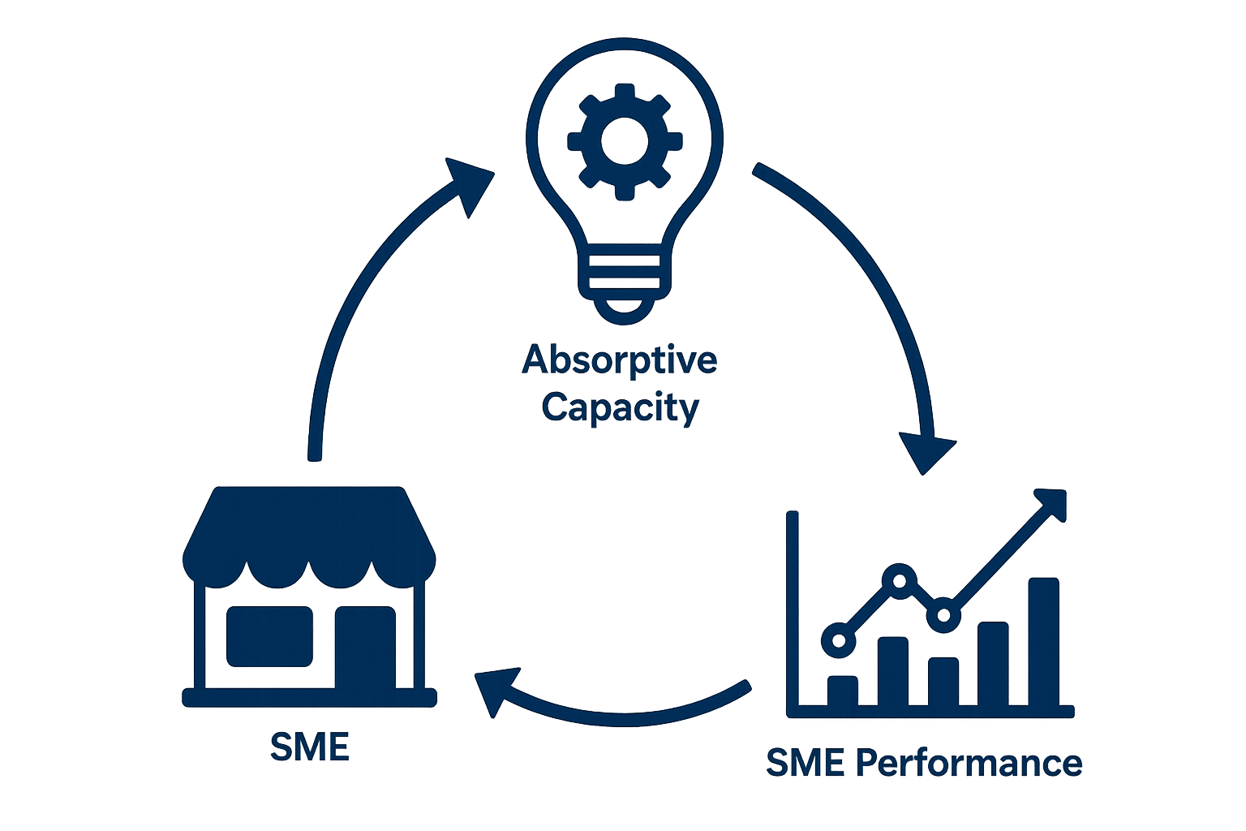
Research Problem & Statement
While absorptive capacity (ACAP) is theoretically known to enhance SME performance, existing empirical studies:
Show inconsistent and context-specific results
Are often limited to single-country or industry-specific data
Do not fully explore moderating factors like geographical regions, cultural dimensions, or time periods
Lack a generalizable understanding of how and when ACAP contributes to SME performance
5

Slide 6

Main Concepts & Definitions
What is Absorptive Capacity (ACAP)?
How to measure it?
Measured as a four-dimensional construct
(Jansen et al., 2005):
“The ability of a firm to recognize the value of new, external information, assimilate it, and apply it to commercial ends.” (Cohen & Levinthal, 1990)
Some studies use:
Learning orientation
Knowledge acquisition ability
Organizational learning capability
ACAP is a strategic learning capability, especially critical in knowledge-intensive industries.
Enables innovation, adaptation, and competitive advantage.
In meta-analysis, these proxies are coded as ACAP to maintain theoretical consistency.
6

Slide 7
Main Concepts & Definitions
What is SME Performance?
How to measure it?
SME performance is a multidimensional concept reflecting a firm’s success across:
💰 Financial (e.g., profitability, revenue)
⚙️ Operational (e.g., efficiency, productivity)
🚀 Strategic (e.g., market share, competitiveness)
💡 Innovative (e.g., product/process innovation) dimensions
Objective: Accounting data (e.g., ROI, sales growth) ↳ Less common due to data privacy in SMEs
Subjective: Manager perceptions via Likert-scale surveys ↳ Widely used in studies (e.g., Ali et al., 2020; Altinay et al., 2016)
Terms used in literature: "Firm Performance", "Overall Performance", "Export Performance", "Growth", etc.
7

Slide 8
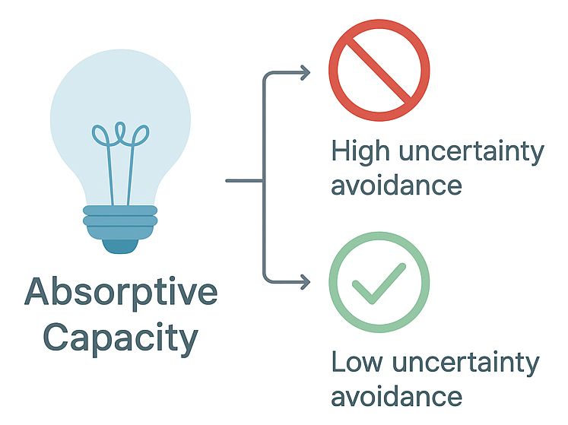
Main Concepts & Definitions
What is Hofstede’s Cultural Dimensions?
Uncertainty Avoidance
Hofstede’s model identifies six cultural dimensions that explain how national cultures affect organizations:
Power Distance
Individualism vs. Collectivism
Masculinity vs. Femininity
Uncertainty Avoidance ← (Focus of this study)
Long-Term vs. Short-Term Orientation
Indulgence vs. Restraint
preference for rules, structure,risk aversion
greater openness to change, experimentation, and external ideas
In high uncertainty avoidance cultures, firms may be more hesitant to adopt external knowledge
In low uncertainty avoidance cultures, firms may be more willing to experiment and adapt
8

Slide 9
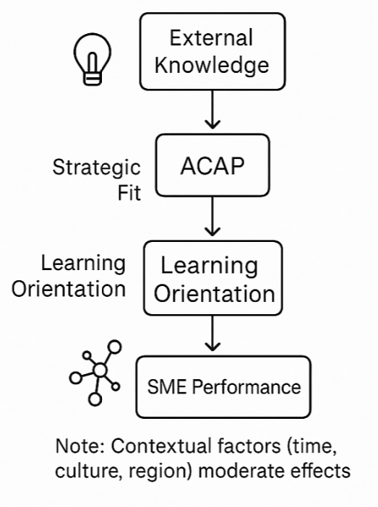
Literature Review (Main Concepts & Definitions Cont.)
Why Absorptive Capacity (ACAP) Matters?
ACAP is Vital for SMEs due to limited internal resources​ (Flatten et al., 2011; Hernández-Linares et al., 2021)​
Enhances performance directly and by strengthening strategic links ( entrepreneurial orientation → firm performance) (Alshahrani & Salam, 2023; Hughes et al., 2018)​
Acts as a bridge from learning orientation to innovation and performance (Alegre & Chiva, 2013).
The relationship is non-linear — too much ACAP can reduce benefits (Wales et al., 2013).
ACAP’s impact varies by country and context (e.g., Malaysia, China) due to environmental and cultural differences.
9

Slide 10
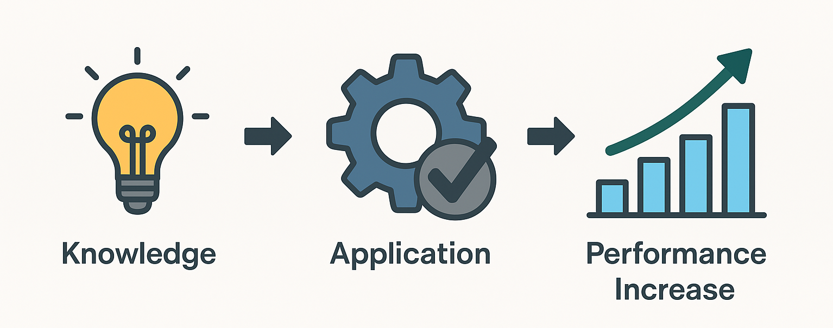
Hypothesis Development & Research Questions
The Direct Impact of Absorptive Capacity on SME Performance
ACAP enables SMEs to translate knowledge into innovation, strategic action, and growth — supported by Alegre & Chiva (2013), Ali et al. (2020), Altinay et al. (2016)
H1: Absorptive capacity is positively associated with SME performance.
10

Slide 11
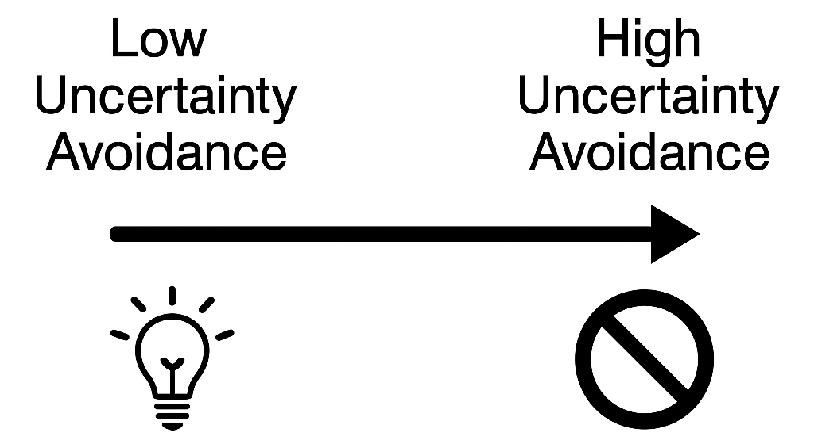
Hypothesis Development & Research Questions
Time as a Moderator of the ACAP–Performance Link
ACAP matures and institutionalizes over time. Later studies show a stronger effect due to learning curves.
H2: The strength of the relationship increases over time.
The Moderating Role of Cultural Uncertainty Avoidance
Cultural values shape firms' openness to change.
H3: The relationship is weaker in countries with high uncertainty avoidance.
11

Slide 12
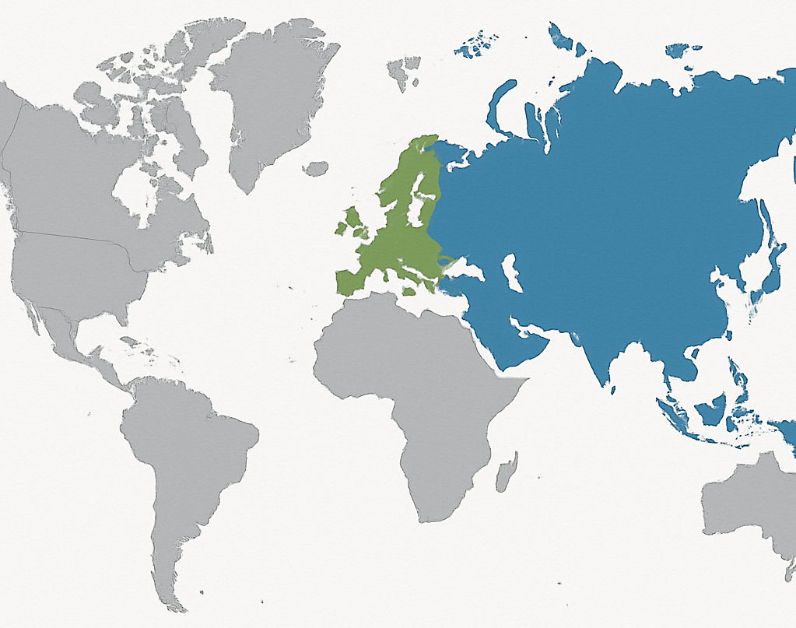
Hypothesis Development & Research Questions
Regional Moderation of the ACAP–Performance Relationship
Asian vs. European firms show structural and cultural variation in knowledge use and innovation.
RQ1: Does the effect differ across world regions?
Industry-Level Moderation of the ACAP–Performance
Knowledge-intensive industries benefit more from ACAP than service-oriented sectors
RQ2: Does the effect differ by industry?
12

Slide 13
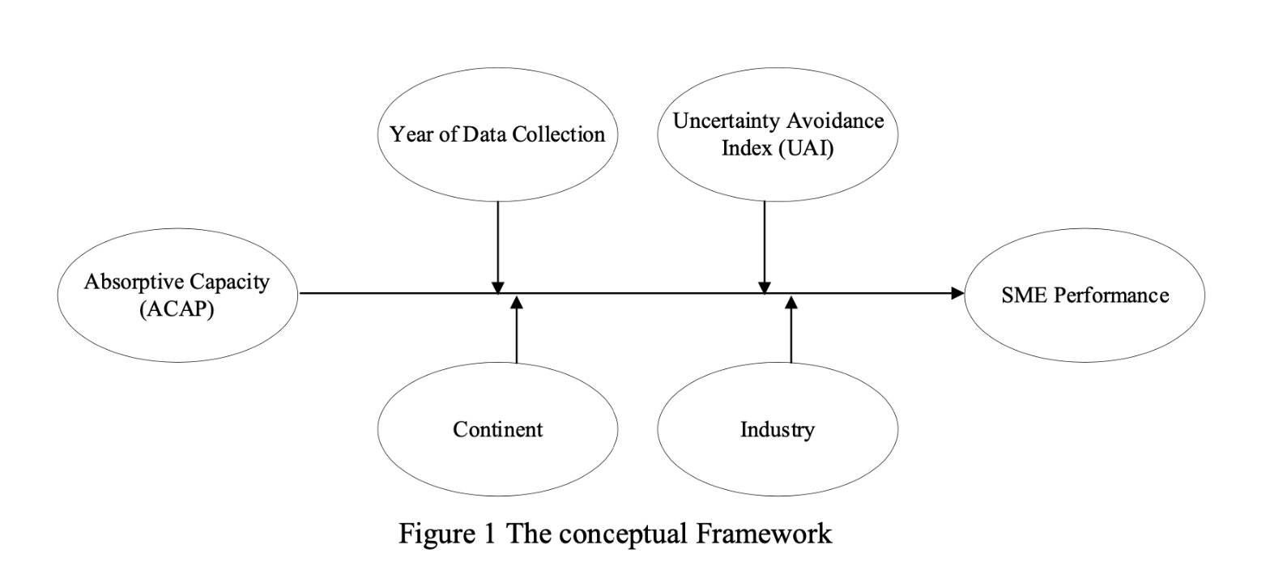
Conceptual Framework
Figure 1 The Conceptual Framework
13

Slide 14
Methodology of The Study
Literature Search
Systematic Meta-Analytic Protocol (Ellis, 2010)
🔍 Searching Steps
Initial keyword search (ACAP, SME performance, learning orientation, etc.)
Manual journal scans (e.g., JIBS, SMJ, IBR)
Forward & backward citation tracking
AI tool integration with ResearchRabbit
Screening via inclusion/exclusion criteria
14

Slide 15
Methodology of The Study
Meta-Analytic Coding Standards
Based on Ellis (2010) and Hunter & Schmidt (2004)
Coding Scheme Variables
Code | Description
N | Sample Size
r/ß | Effect Size
α / CR | Reliability
Year | Publication or data collection year
Journal | Source journal, eigenfactor
Firm data | Size, age, country, industry
Moderators | Region (1-5), Industry(1-3)
Independent Variable: Absorptive Capacity
Mostly Jansen et al. (2005) 4D model
Some studies use proxies:
Learning orientation
Organizational learning capability
If subdimensions available, they were included as separate effects
Dependent Variable: SME Performance
15

Slide 16
Methodology of The Study
Meta-Analytic Model
Bivariate random-effects meta-analysis
Accounts for heterogeneity across studies (contextual, methodological, etc.)
Follows Ellis (2010) and Hunter & Schmidt (2004) standards
Heterogeneity Assessment
Tools used:
Cochran’s Q
I² index (>25% = significant heterogeneity)
Moderator Analyses
Categorical moderators (e.g., continent): → Q-between subgroup analysis
Continuous moderators (e.g., firm age, UAI): → Meta-regression with k-weighted least squares
Reported: β, R², F, p-value
Publication Bias Checks
Methods:
Funnel plot
Egger’s regression test
If bias present: → Trim-and-fill adjustment
Sensitivity analysis: → Outlier removal + low-reliability exclusion
16

Slide 17
Results – Descriptive Overview
39 studies (2003–2022 data collection; 2008–2024 publication years)
Mean sample size: 257 (range: 70–588)
Response rates: 7.5% to 88.8% (mean: 37.0%)
Studies span 22 countries and 5 continents
Most frequent journals: Journal of Small Business Management, Management Decision, Journal of Knowledge Management….
Predominantly focused on SMEs (k = 34)
17

Slide 18
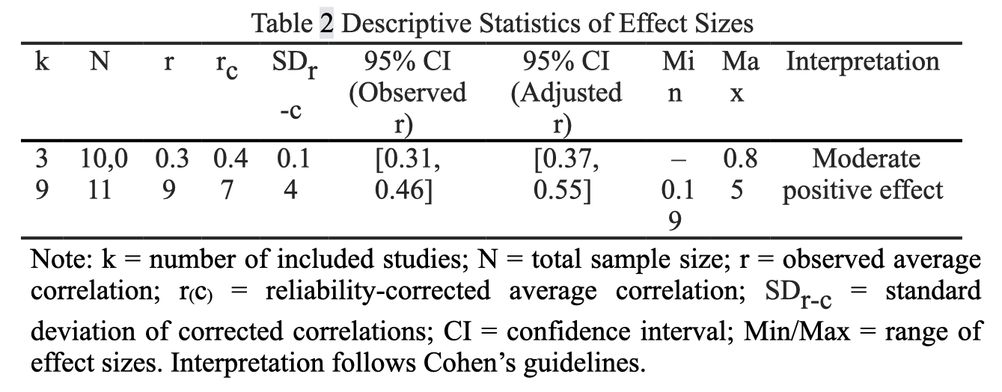
Results – Meta-Analytic Effect
18

Slide 19
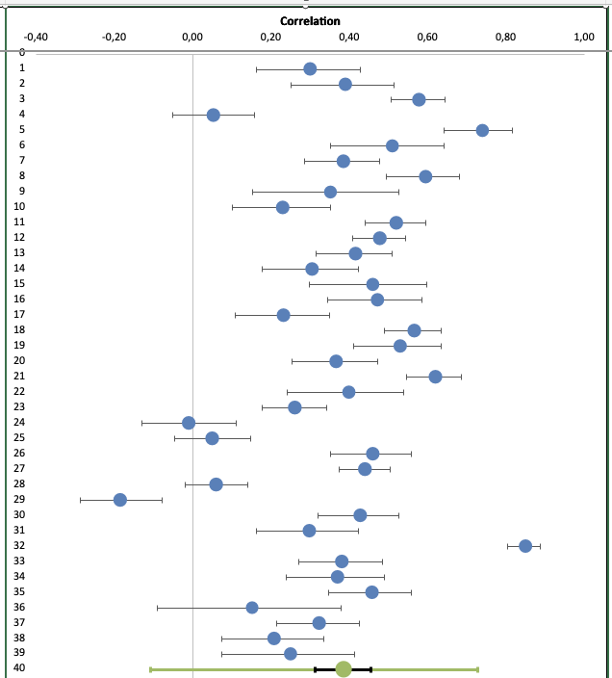
Results – Forest Plot Visualization
Visualizes effect sizes (correlations) and 95% confidence intervals for all 39 studies
Each dot represents a study; longer lines show greater uncertainty
Green diamond indicates the pooled average effect size
Most effects are positive, supporting a consistent ACAP–performance relationship
19

Slide 20
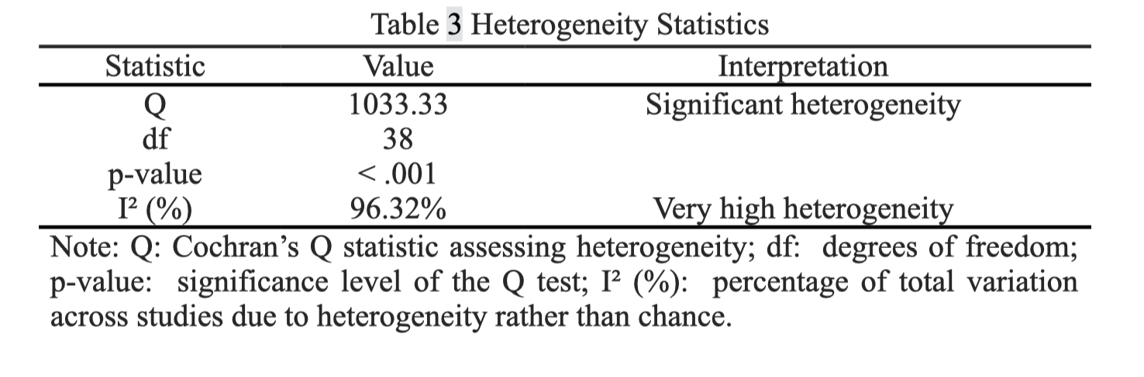
Results – Heterogeneity Assessment
20

Slide 21
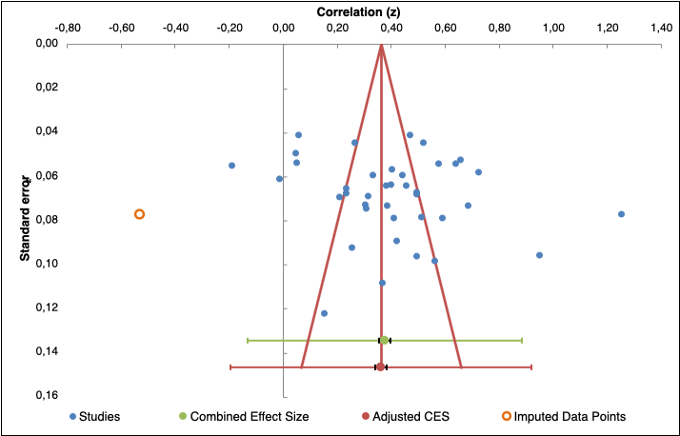
Results - Publication Bias Assessment
Funnel Plot Assessing Publication Bias
The funnel plot appears largely symmetrical, indicating low risk of publication bias.
Trim-and-fill imputed only one study (orange dot), with negligible change in effect size (z = 0.38 → z = 0.36).
21

Slide 22
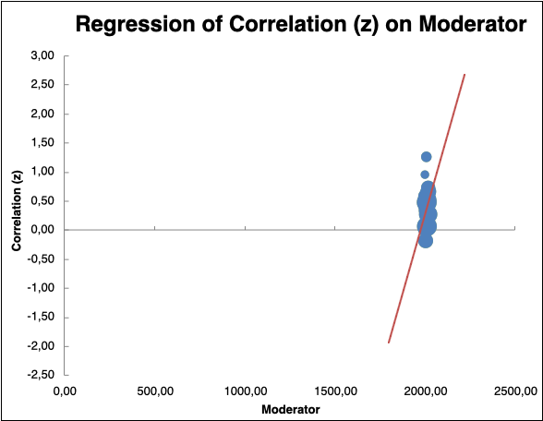
Results – Moderator Analyses Year of Data Collection
The analysis showed a significant positive effect:
β = 0.23
Z = 5.70
p < .001
Note: Each bubble represents a study, with size proportional to sample size. The upward slope shows that effect sizes have increased in more recent years.
22

Slide 23
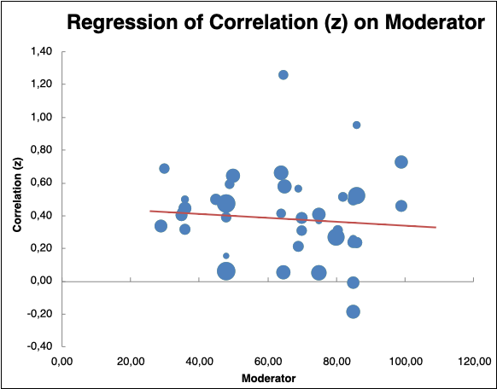
Results – Moderator Analyses UAI
The analysis revealed a significant negative relationship:
β = –0.09
Z = –2.30
p = .022
Each bubble represents a study, with size proportional to sample size. The red regression line shows a downward trend in correlation strength as UAI increases.
23

Slide 24
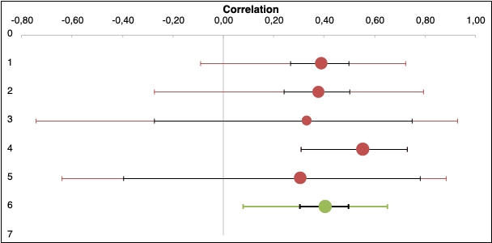
Results – Moderator Analyses Continents
Continents were coded as follows: 1 = Europe
2 = Asia
3 = North America
4 = Australia
5 = Other (Africa + South America).
Note: Effect sizes and 95% confidence intervals are shown for each continent. The grouped “Other” category ensures statistical stability due to limited study counts from Africa and South America.
24

Slide 25
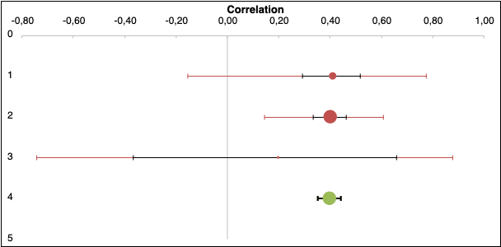
Results – Moderator Analyses Industry type
Industry types were coded as follows: 1 = Manufacturing
2 = Services
3 = Mixed/Other.
Confidence interval overlap across industry types suggests limited moderating influence of industry on the ACAP–performance link.
25

Slide 26
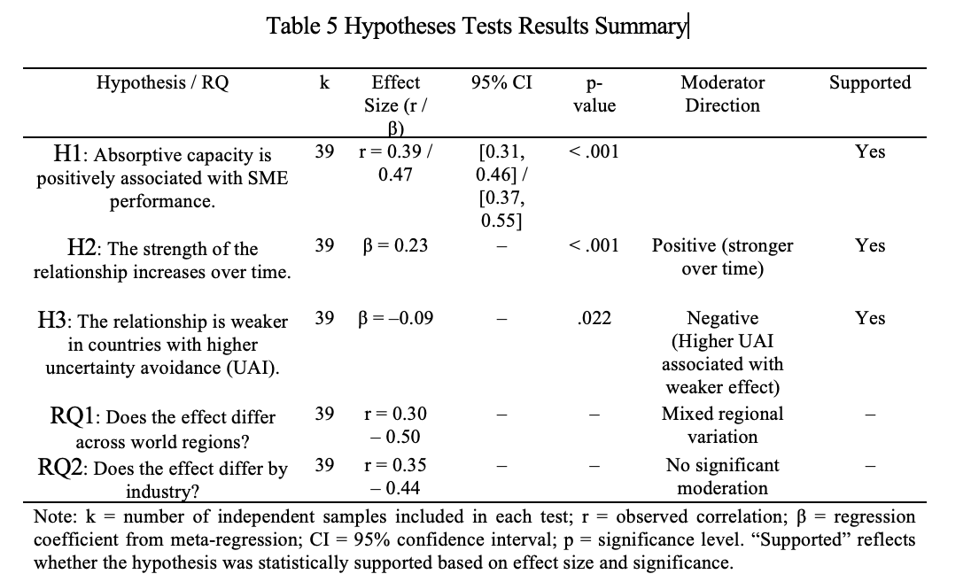
Results – Hypotheses Summary
26

Slide 27
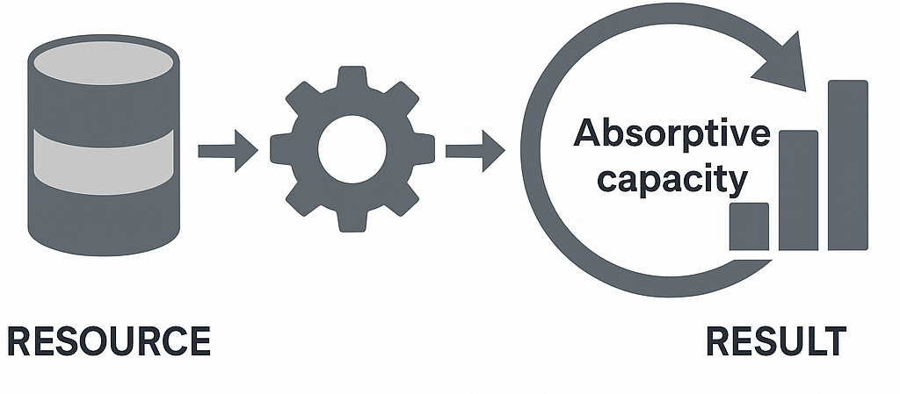
Discussion – Theoretical Implications
ACAP as Resource
Contextual Moderation
Regional Variation
Confirms Resource-Based View
ACAP = valuable intangible capability
Enhances competitive advantage
Time moderates the relationship → Digital transformation and knowledge flow = stronger ACAP impact
Culture matters → High uncertainty avoidance weakens the ACAP–performance link
ACAP’s impact is not universal
Varies by:
Geography (e.g., Asia vs Europe)
Industry (e.g., knowledge-intensive vs service)
27

Slide 28
Discussion – Practical Implications
Invest in Knowledge Capabilities
Adapt to Cultural Context
Context-Specific ACAP Strategies
ACAP strengthens performance
Managerial takeaway:
Support training, IT systems, and collaboration
Why now? → ACAP impact is increasing over time
In high uncertainty avoidance cultures: → ACAP works less effectively
Recommendation:
Encourage experimentation
Create a safe-to-fail environment
Adjust decision-making processes for flexibility
ACAP effect varies by:
Region
Industry
Policy suggestion:
Support underrepresented regions & sectors
Promote knowledge sharing via incentives/programs
28

Slide 29
Discussion – Limitations & Future Research
Future Directions
Explore non-linear effects
Include more diverse regions (e.g., Africa, South America)
Examine digitalization & strategic orientation
Use longitudinal & multi-level models
Distinguish potential vs. realized ACAP
Limitations
Regional bias (mostly Europe & Asia)
Industry imbalance (few service-sector studies)
Missing firm-level data (age, size)
No sensitivity checks (to keep all studies)
29

Slide 30
References
Alegre, J., & Chiva, R. (2013). Linking entrepreneurial orientation and firm performance: The role of organizational learning capability and innovation performance. Journal of small business management, 51(4), 491-507.
Ali, I., Ali, M., Salam, M. A., Bhatti, Z. A., Arain, G. A., & Burhan, M. (2020). How international SME's vicarious learning may improve their performance? The role of absorptive capacity, strength of ties with local SMEs, and their prior success experiences. Industrial Marketing Management, 88, 87-100.
Alshahrani, M. A., & Salam, M. A. (2023). Entrepreneurial orientation and SMEs performance in an emerging economy: the mediating role of absorptive capacity. Journal of Research in Marketing and Entrepreneurship, 26(1), 1-24.
Altinay, L., Madanoglu, M., De Vita, G., Arasli, H., & Ekinci, Y. (2016). The interface between organizational learning capability, entrepreneurial orientation, and SME growth. Journal of small business management, 54(3), 871-891.
Cohen, W. M., & Levinthal, D. A. (1990). Absorptive capacity: A new perspective on learning and innovation. Administrative science quarterly, 35(1), 128-152.
Hughes, P., Hodgkinson, I. R., Hughes, M., & Arshad, D. (2018). Explaining the entrepreneurial orientation–performance relationship in emerging economies: The intermediate roles of absorptive capacity and improvisation. Asia Pacific Journal of Management, 35, 1025-1053.
J. J., Van Den Bosch, F. A., & Volberda, H. W. (2005). Managing potential and realized absorptive capacity: how do organizational antecedents matter? Academy of management journal, 48(6), 999-1015.
W. J., Parida, V., & Patel, P. C. (2013). Too much of a good thing? Absorptive capacity,
firm performance, and the moderating role of entrepreneurial orientation. Strategic
management journal, 34(5), 622-633.
W. M., & Levinthal, D. A. (1990). Absorptive capacity: A new perspective on learning and innovation. Administrative science quarterly, 35(1), 128-152.
30

